Slide 1

Technical Exam
- Data Analyst
Author: Ming-Tsung (Julius) Lee

Slide 2
Context
Formula for Life Time Value for a Particular Cohort
Factors That Impact the Length
Monthly Retention Curve
Cumulative Retention Curve
Cumulative Retention Curve for 2019 Cohorts’ Prediction
Other findings
1

Slide 3
Formula for Life Time Value for a Particular Cohort
Metrics:
Monthly Retention Rates across the cohort lifetime (MRR)
Commission Per Member Per Month (CMPM)
Interest Rate (IR)
Member count for the cohort (Mem_Cnt)
2

Slide 4
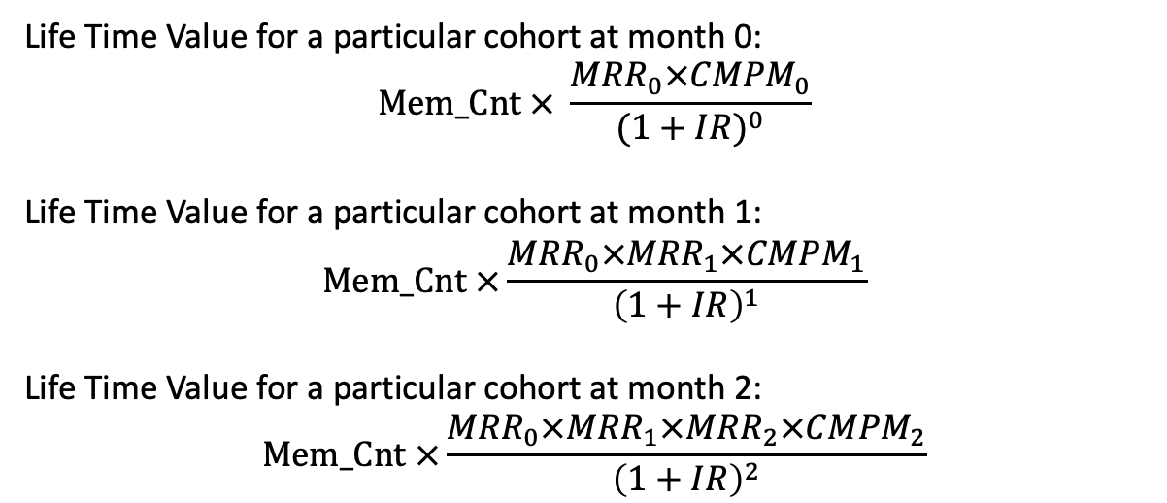
Formula for Life Time Value for a Particular Cohort
Life Time Value for a particular cohort at month 0:
$$Mem_Cnt × \frac{{MRR}_{0}×{CMPM}_{0}}{{(1+IR)}^{0}}$$
Life Time Value for a particular cohort at month 1:
$$Mem_Cnt ×\frac{{{MRR}_{0}×MRR}_{1}×{CMPM}_{1}}{{\left(1+IR\right)}^{1}}$$
Life Time Value for a particular cohort at month 2:
$$Mem_Cnt ×\frac{{{{MRR}_{0}×MRR}_{1}×MRR}_{2}×{CMPM}_{2}}{{\left(1+IR\right)}^{2}}$$
3

Slide 5
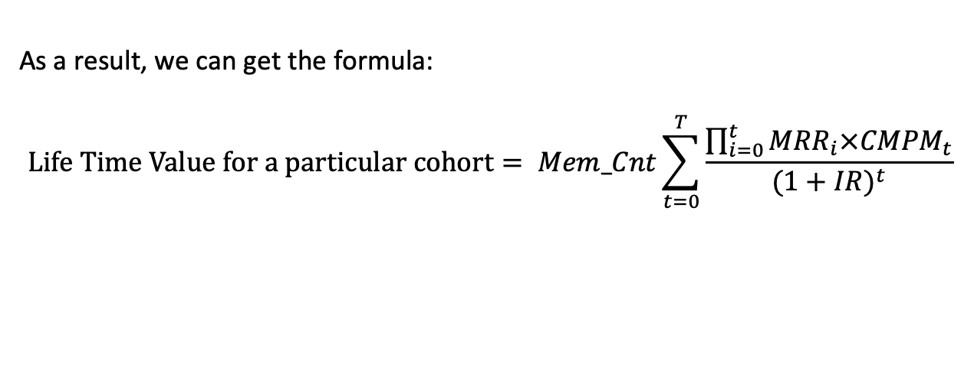
Formula for Life Time Value for a Particular Cohort
As a result, we can get the formula:
$$Life Time Value for a particular cohort= Mem_Cnt\sum_{t=0}^{T}{\frac{\prod_{i=0}^{t}{{MRR}_{i}×{CMPM}_{t}}}{{(1+IR)}^{t}}}$$
4

Slide 6
Improve the Formula for Life Time Value for a Particular Cohort
Add more variables:
Cancellation Value: Refund return to customer if cancelled.
Cross-Selling Value: Additional insurance revenue from existing customers.
Claim Value: Cost if the event happened.
5

Slide 7
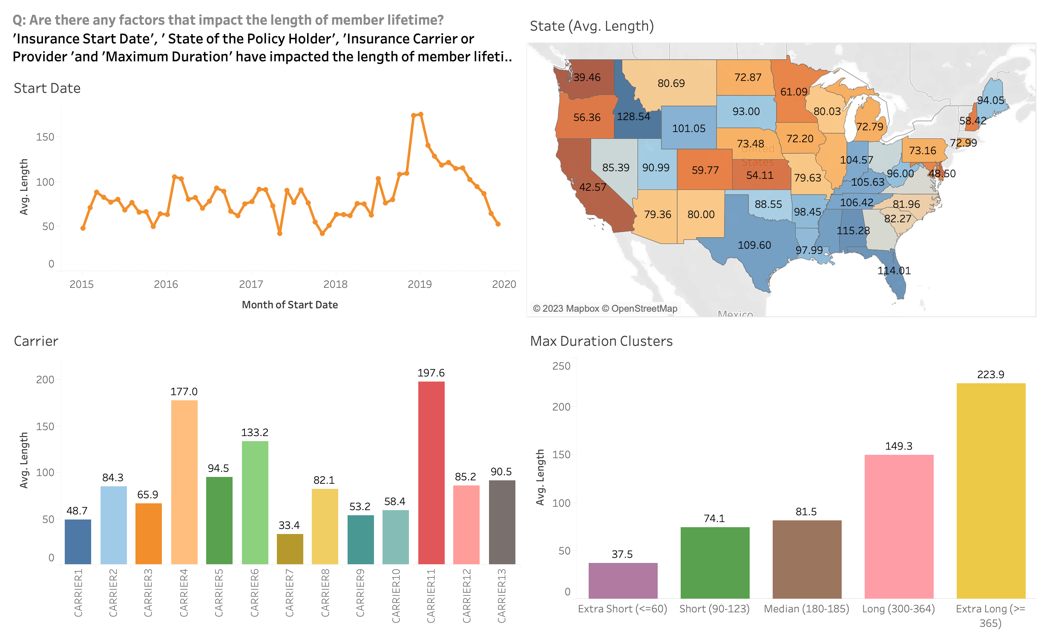
Factors That Impact the Length
6

Slide 8
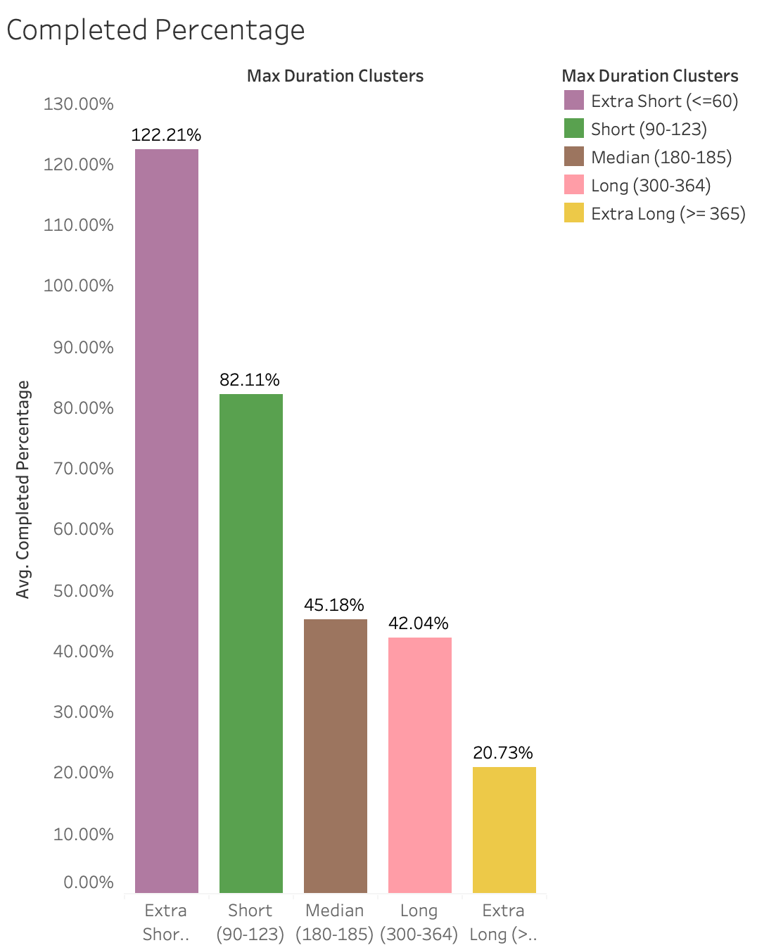
Relationship between Length and Max Duration
Completed Percentage (Length/Max Duration):
When the maximum duration is longer, there is a higher likelihood that people will churn.
People who have an extra short policy not only complete the whole duration but also extend it for several days.
7

Slide 9
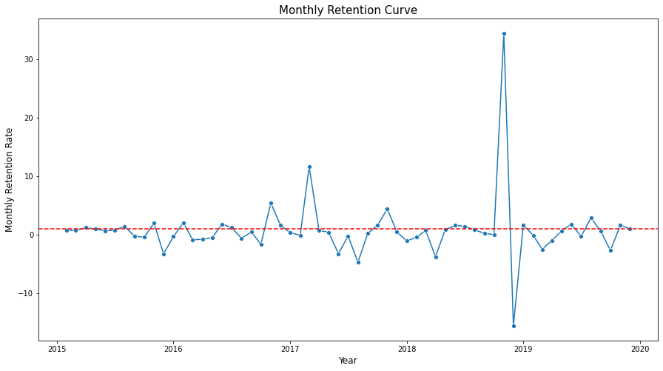
Monthly Retention Curve
The majority of the monthly retention rates hover around 1. However, there are significant changes in March 2017, November 2018, and December 2018, meaning that some events might happen around March 2017 and November 2018 because the proportion between new users and churn users has changed.
8

Slide 10
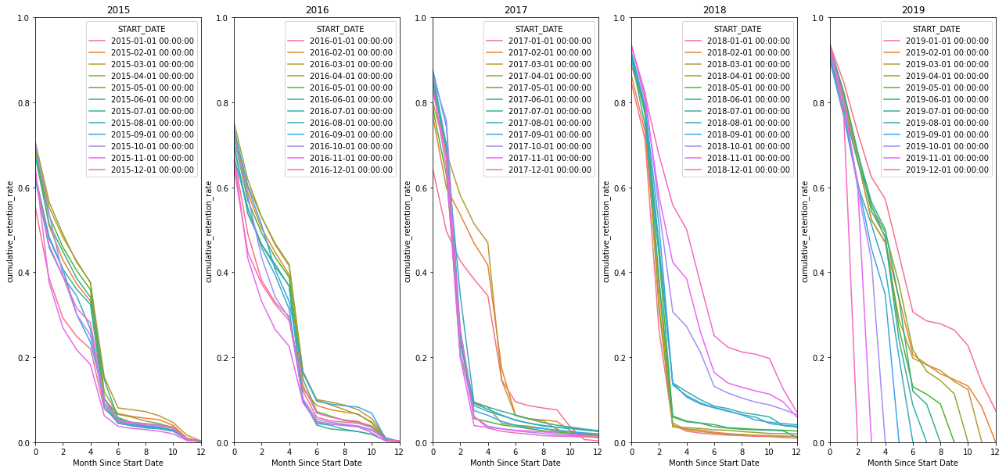
Cumulative Retention Curve
9

Slide 11
Cumulative Retention Curve
Based on the line charts shown, it is evident that there are primarily two types of Cumulative Retention Curves. The first one demonstrates a gradual decline from month 2 to month 4. Conversely, the second type experiences a significant drop during the same time period.
If the cohort start date falls before April 2017 or after September 2018, the Cumulative Retention Curve will be similar to the first type. However, if the cohort start date falls between April 2017 and September 2018, the Cumulative Retention Curve will look like the second type. This indicates that an event or circumstance may have occurred during the period of April 2017 to September 2018, resulting in a change in the Cumulative Retention Curve.
10

Slide 12
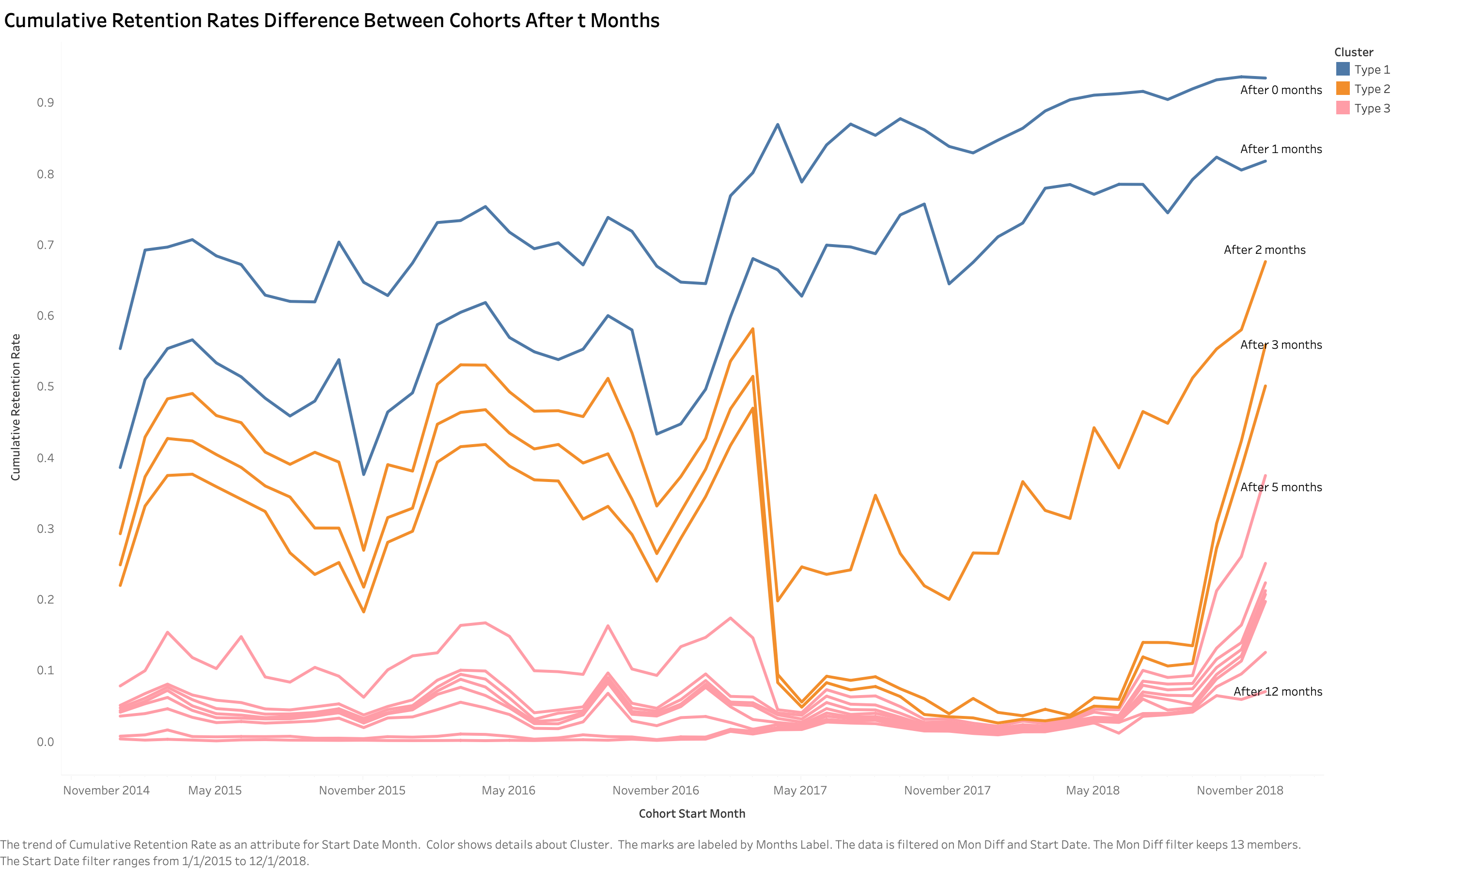
Cumulative Retention Curve for 2019 Cohorts’ Prediction
Cumulative Retention Rates Difference Between Cohorts After t Months:
Three types:
Gradual upward slope
A significant drop after April 2017, and a large increase after September 2018.
Consistently low but increases after September 2018.
11

Slide 13
Cumulative Retention Curve for 2019 Cohorts’ Prediction
Type 1:
Built ARIMA models to handle time series data and utilized them to make predictions.
Type 2:
Assuming something might have happened during the period between April 2017 and September 2018, and excluded this data and calculated the moving average to forecast future Cumulative Retention Rates.
Type 3:
Computed the average of the same month to predict future Cumulative Retention Rates.
12

Slide 14
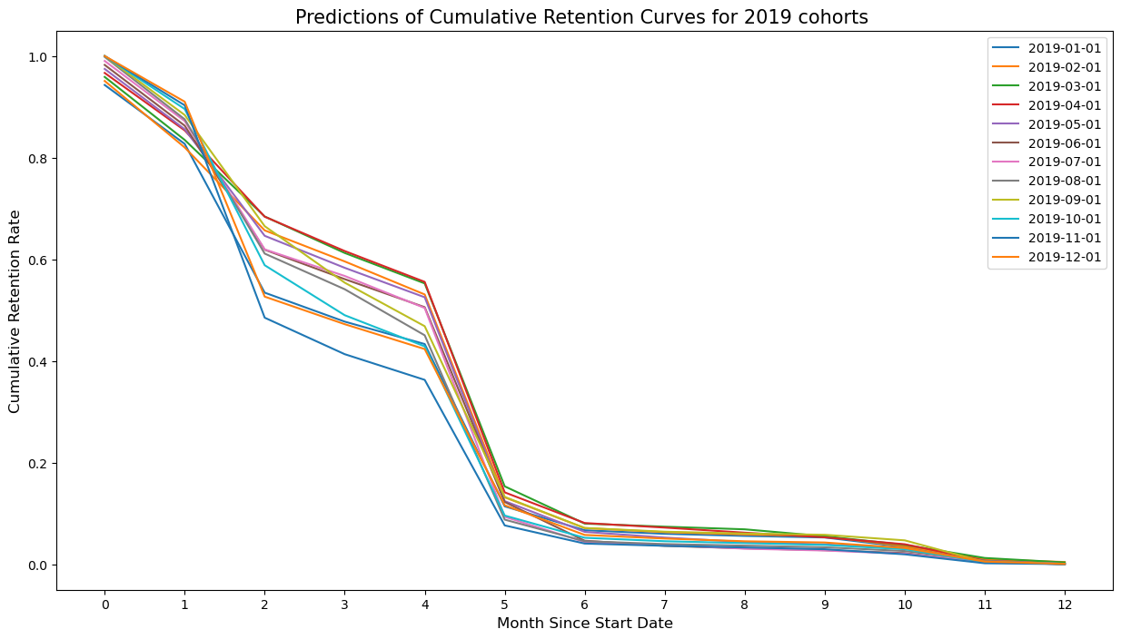
Cumulative Retention Curve for 2019 Cohorts’ Prediction
My prediction of the Cumulative Retention Curve for 2019 cohorts:
13

Slide 15
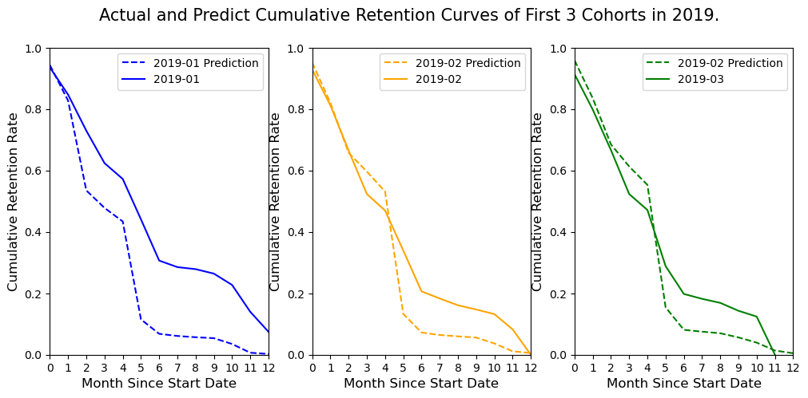
Cumulative Retention Curve for 2019 Cohorts’ Prediction
Compare the first 3 months of actual and predict Cumulative Retention Curve:
The predicted curves experience a significant drop in the fifth month. However, in reality, the actual curves only show a relatively slight decrease in the fifth and sixth months.
14

Slide 16
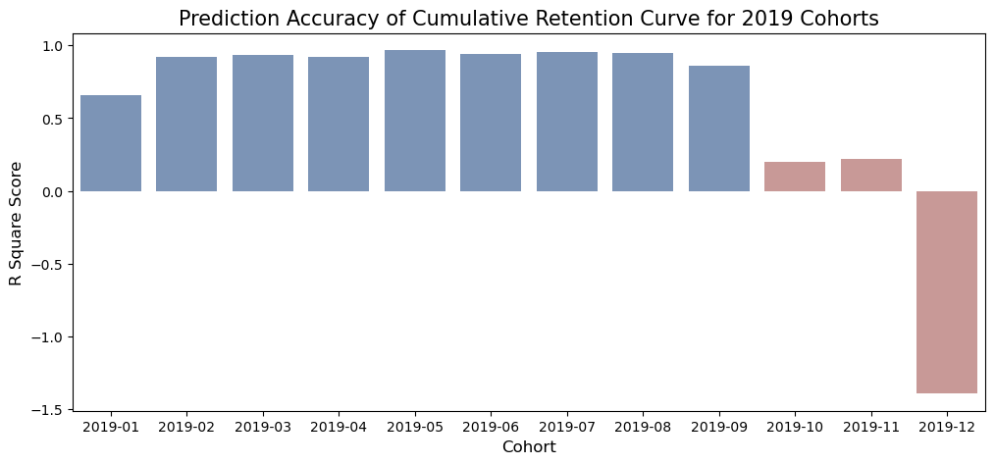
Cumulative Retention Curve for 2019 Cohorts’ Prediction
The histogram reveals that the predictions are accurate for the first nine cohorts in 2019 but perform poorly for the last three cohorts. It is because of the smaller amount of data available for the last three cohorts, resulting in lower prediction accuracy.
15

Slide 17
Other Findings
Prior to the insurance start date, more than 5000 customers had already churned. (Churn Date < Start Date)
There may be some relationship between Insurance carrier or provider and State of the policy holder.
16

